Slide 1
Frame Interpolation via AdaConv in PyTorch
Refence Paper: Video Frame Interpolation via Adaptive Convolution
Original Author: Simon Niklaus, Long Mai, Feng Liu
Presentor: Zhiyun Ling

Slide 2
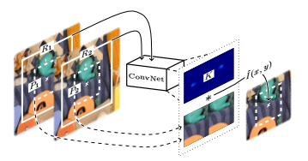
Introduction
Traditional Frame Interpolation Method
Motion estimation (Optical Flow)
Pixel Synthesis
Problem
Abrupt brightness change
Blur
Occlusion
Artifacts in interpolation
AdaConv by Niklaus et al.
Fully Convolutional Networks
Adaptive Convolution
Combine two steps

Slide 3
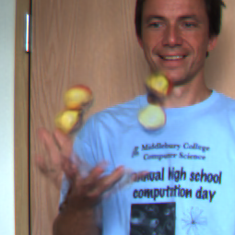
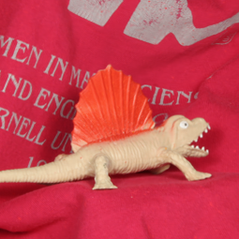
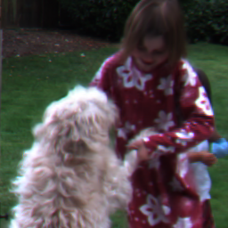
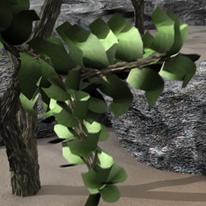
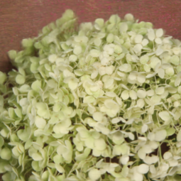
Brief
Implement: A fully convolutional neural networks + adaptive convolution
Interpolate the middle frame temporally using two consecutive frames
Final Model Generates visually pleasant resulting frames/videos
The evaluation scores are near the original paper, but still a gap

Slide 4
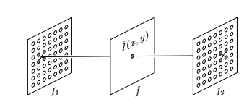
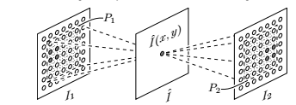
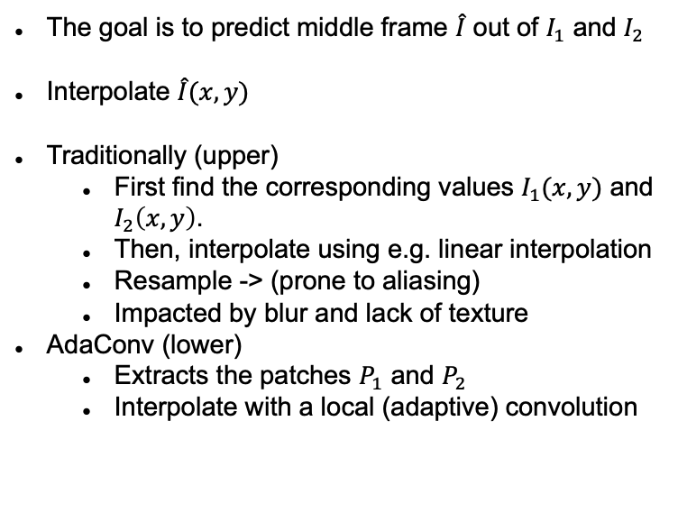
Interpolation
The goal is to predict middle frame $\hat{I}$ out of $I_{1}$ and $I_{2}$
Interpolate $\hat{I}(x,y)$
Traditionally (upper)
First find the corresponding values $I_{1}(x,y)$ and $I_{2}\left(x,y\right)$.
Then, interpolate using e.g. linear interpolation
Resample -> (prone to aliasing)
Impacted by blur and lack of texture
AdaConv (lower)
Extracts the patches $P_{1}$ and $P_{2}$
Interpolate with a local (adaptive) convolution

Slide 5
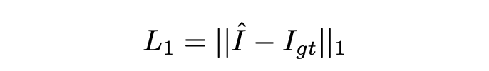
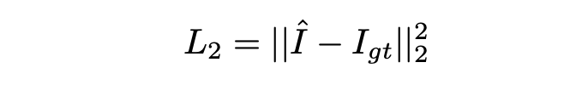
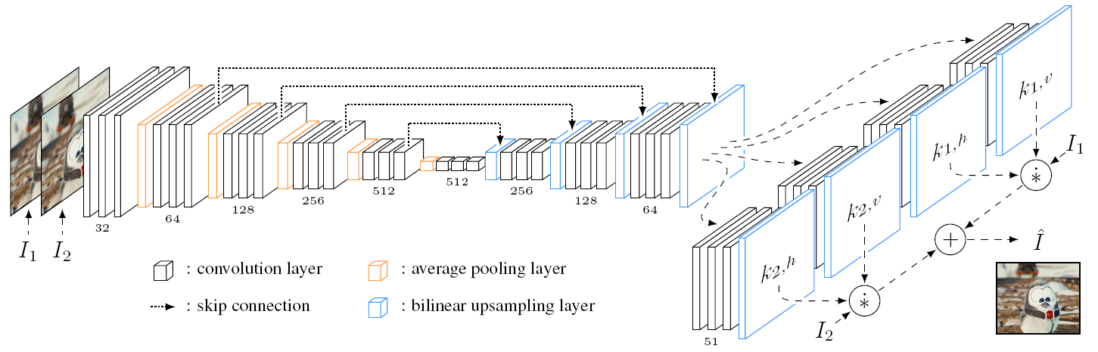
Model
Using the same model as in Niklaus et al.
AutoEncoder with skip connections
Local Separable Convolution
L1 Loss vs L2 Loss

Slide 6
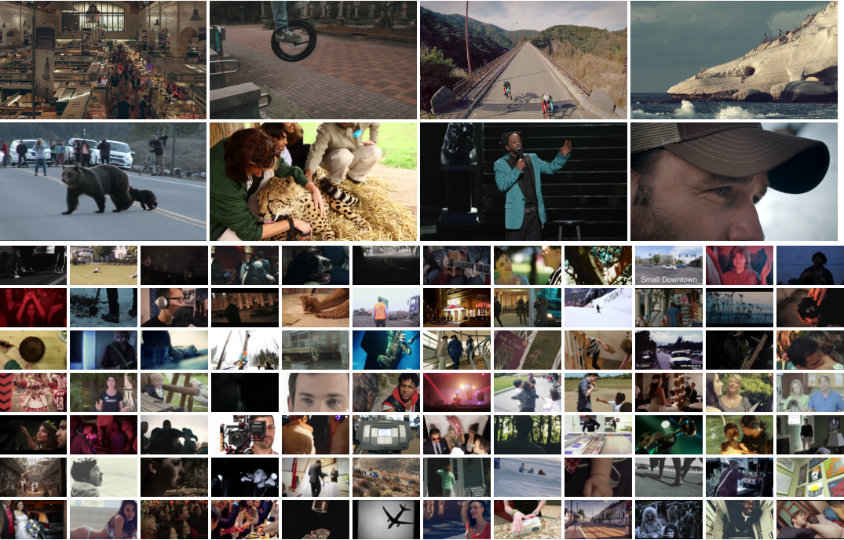
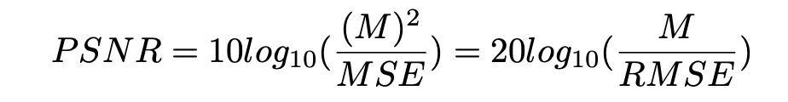
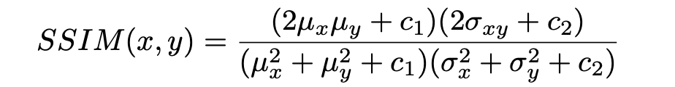
Implementation
Using PyTorch and CuPy. (Only works on CUDA environment)
Train with Vimeo Dataset (73171, 33GB)
Train:validation =14:1
Visual evaluation using Middlebury dataset
Generate Video using DAVIS2017 dataset
Quantitative Evaluation using validation dataset
PSNR
SSIM

Slide 7
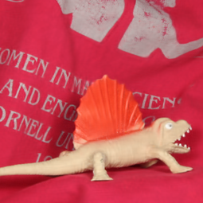
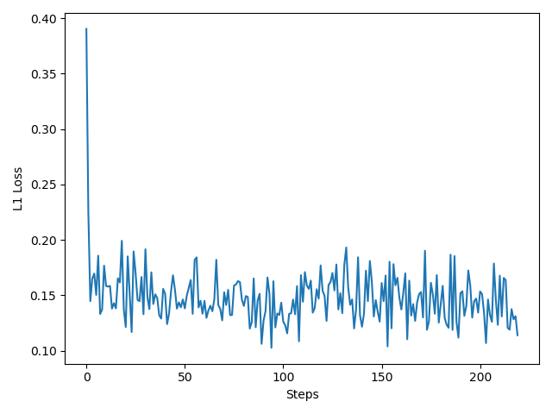
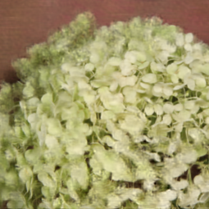
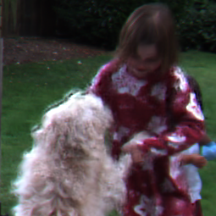
Results
L1 loss vs L2 loss
Loss Curve

Slide 8
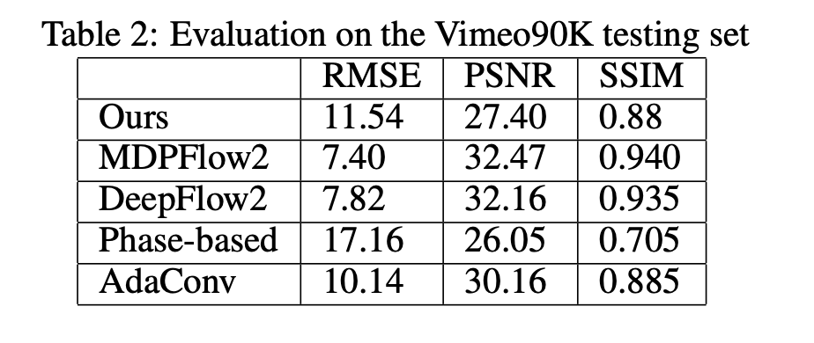
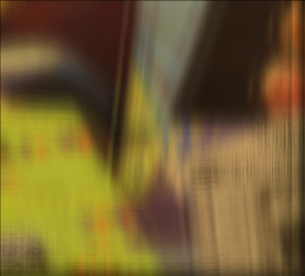
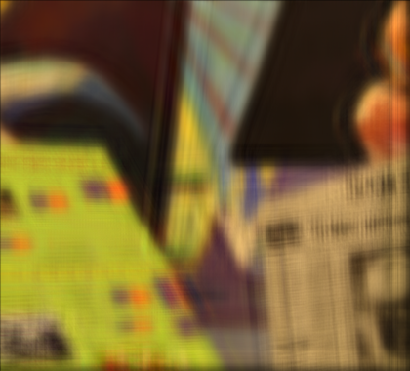


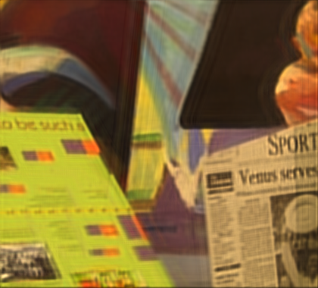

Results
Intermediate Results
Quantitative Evaluation

Slide 9

Results
Generate Video Using DAVIS2017 dataset
15fps – 30fps videos
https://youtu.be/rwKO0PGu9o4
Demo Video

Slide 10
Thanks!

